Slide 1

Default Dataset – EDA, KNN, Logistic Regression
By Jonathan Ryan Wilianto

Slide 2
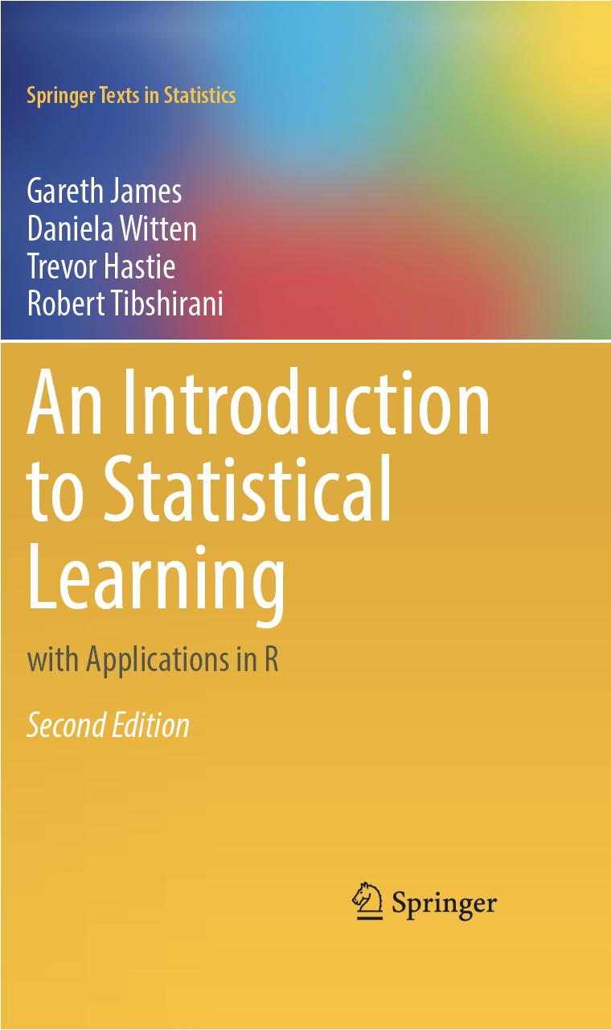
INTRODUCTION
The Default dataset is a generated dataset from the ISLR Package in R. The ISLR Package complements the ISLR book. You can download the first edition of the book here https://www.statlearning.com/

Slide 3
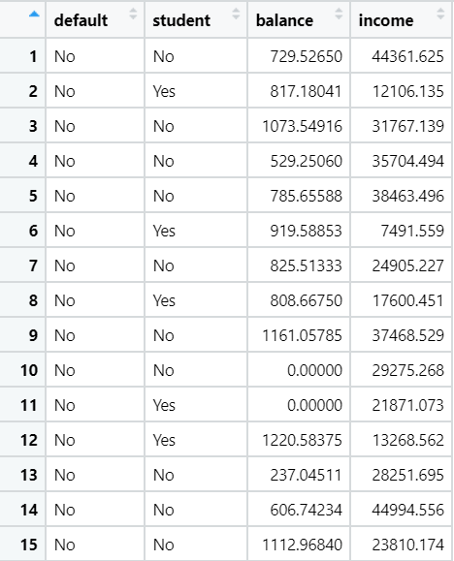
INTRODUCTION
Here are the first 15 rows of the dataset. There are 10000 rows in total. This is a simulated dataset. It is not a real data from a real company.
There are only 4 variables. The variables are self explanatory except for balance:
Balance is the average balance that the customer has remaining on their credit card after making their monthly payment

Slide 4
INTRODUCTION
Student
In this project we will predict default based on the other 3 variables using Logistic Regression Model and KNN. In other words we would like to know whether a customer will default based on his/her income and balance level as well as student status. We would like to know which approach performs better.
There is no need to clean the dataset as it is already clean. We will perform Exploratory Data Analysis before we do any modelling. All of the R codes used in this analysis can be seen here https://github.com/JonathanRyanW/ISLR_Default
Income
Default
Balance

Slide 5
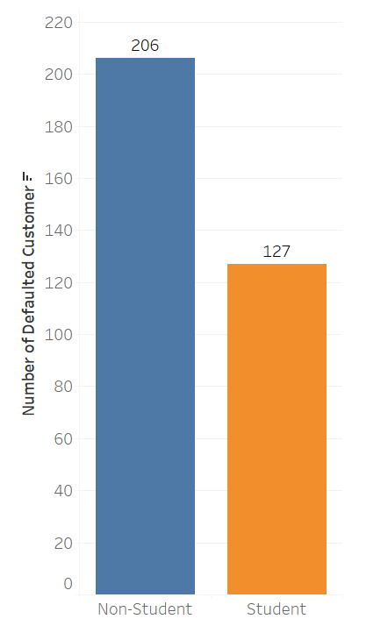
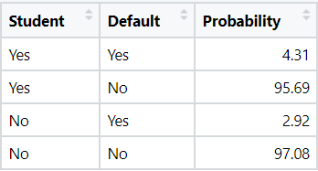
EXPLORATORY DATA ANALYSIS
Out of 10000 customer, only 333 people defaulted. 206 (61.86%) of them are non-students while 127 (38.13%) of them are students. This doesn’t necessarily means that non-students are more likely to default because there are way more non-students than students.
There are 7056 non-students and 2944 students. The probability (in percentage) of default for each category is as follows:
It turns out students are more likely to default than non-students. Given that we do not have any other information about their income and balance.

Slide 6
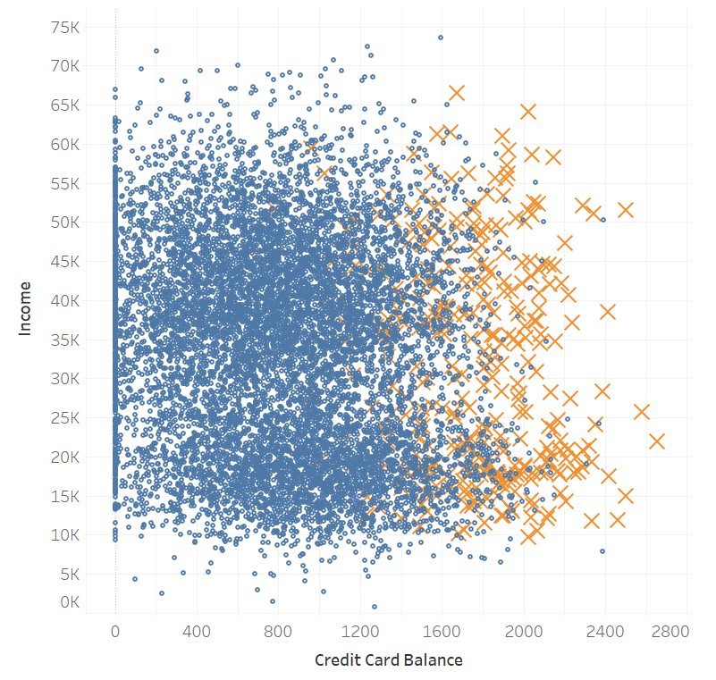
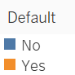
EXPLORATORY DATA ANALYSIS
This is a scatterplot between balance and income colored by default category.
It looks like the higher the balance, the more likely someone is to default. Income, on the other hand, doesn’t seem to affect the default probability.

Slide 7
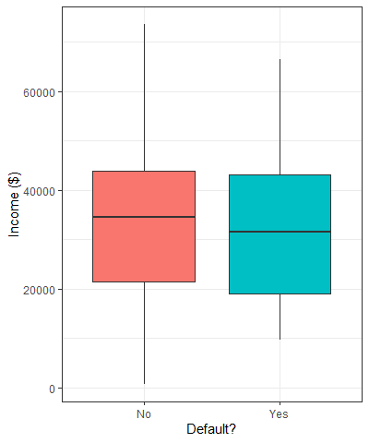
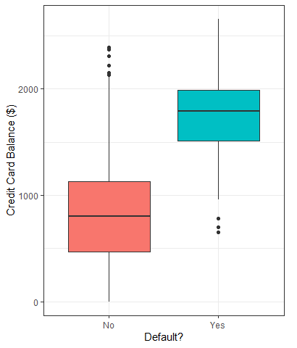
EXPLORATORY DATA ANALYSIS
As we can see in these 2 boxplots. There is almost no difference of income between defaulted and non- defaulted customers.
On the other hand people who defaulted have significantly higher balance in general than those who didn’t default.

Slide 8
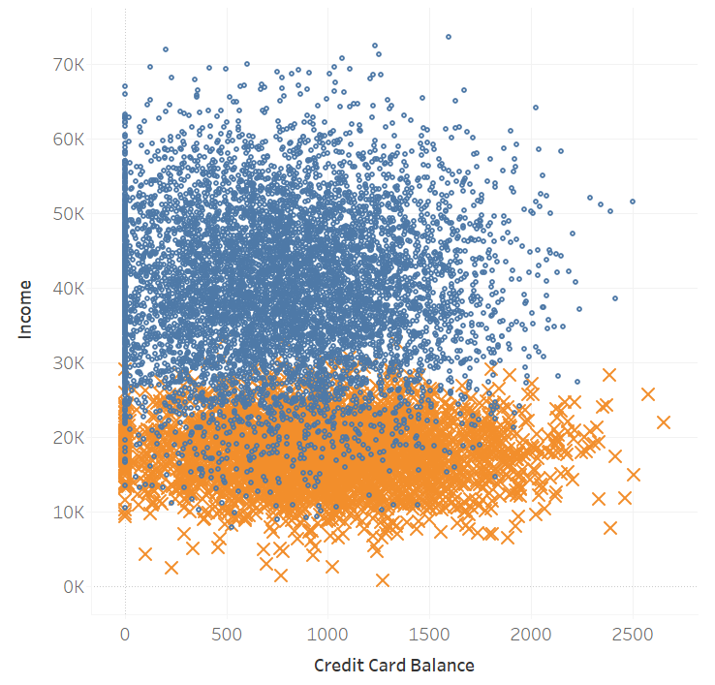
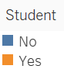
EXPLORATORY DATA ANALYSIS
This is a scatterplot between balance and income colored by student category.
Students have significantly lower income than non-students. This is expected as students are most likely not working (The fact makes sense, but keep in mind that this is a simulated dataset).

Slide 9
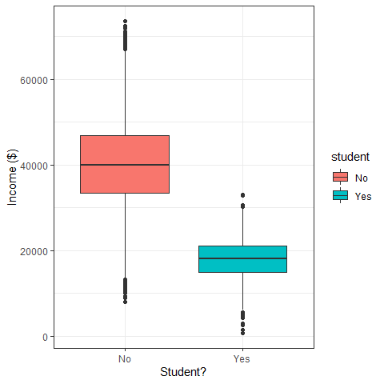
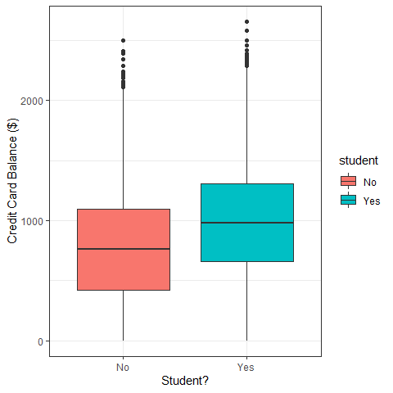
EXPLORATORY DATA ANALYSIS
As we can see in these 2 boxplots. Students have significantly lower income and slightly higher balance than non-students.
Now that EDA is done, we will proceed with building our Logistic Regression Model.

Slide 10
LOGISTIC REGRESSION
We will build a Logistic Regression Model to predict which customer will default based on the student, income, and balance variables. To see the codes used in this analysis please visit:
https://github.com/JonathanRyanW/ISLR_Default/blob/master/script/Logistic%20Regression.R

Slide 11
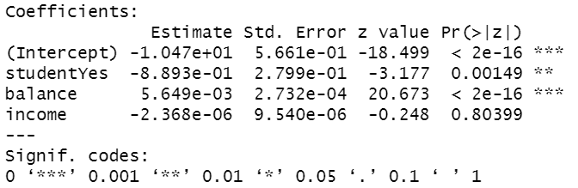
LOGISTIC REGRESSION
Here is the summary of our model.
All of the variables (except income) influence default. It can be seen from the tiny p values.

Slide 12
LOGISTIC REGRESSION
Here is the summary of our model.
All of the variables (except income) influence default. It can be seen from the tiny p values.
Income doesn’t affect default. The p-value is 0.80. This is a very large p value. The same observation can be derived from the scatterplot on Page 6 and box plot on Page 6.

Slide 13
LOGISTIC REGRESSION
Here is the summary of our model.
All of the variables (except income) influence default. It can be seen from the tiny p values.
Income doesn’t affect default. The p-value is 0.80. This is a very large p value. The same observation can be derived from the scatterplot on Page 6 and the left box plot on Page 7.
The balance coefficient is positive (5.649e-03). Giving evidence that higher balance indeed indicates higher probability to default.

Slide 14
LOGISTIC REGRESSION
The studentYes coefficient is negative. Indicating that students are less likely to default compared to non students. This coefficient may seem to contradict our findings on Page 5 which states that students are more likely to default compared to non-students.
However there is no contradiction here. They are both true. This is a phenomenon known as Confounding. It happens because the student and balance variables are correlated.

Slide 15
CONFOUNDING
Our analysis on Page 5 shows that if we do not have any information about about a student and a non-student, the student is more likely to default.
However, the Logistic Regression Model tells us that if we know that they have the same income and balance then the student is less likely to default.
It happens because students generally have higher balance (Second boxplot on Page 9) and balance itself is associated with higher default rate (Second boxplot on Page 7).
This means that even though students are less likely to default than a non student with the same income and balance, overall students are more likely to default because they tend to have higher balance!
Being a student
Higher balance
Higher probability to default

Slide 16
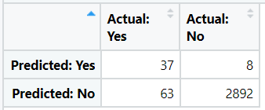
LOGISTIC REGRESSION
Our Logistic model successfully predicted the correct default category 97.63% of the time (2929 times out of 3000 attempts).
Here is the confusion matrix for this model.
Our model has a high accuracy, but low sensitivity. This fact might be problematic as most credit card companies would like to accurately predict customers who actually defaulted. They care less much about predicting customers who are not going to default at all.
Now that the Logistic Regression Model is done we will proceed with KNN.
Sensitivity: 37/100 = 37%
Specificity: 2892 / 2900 = 99.72%

Slide 17
K NEAREST NEIGHBORS
We will perform KNN to predict which customer will default based on the student, income, and balance variables. To see the exact codes I used on this analysis please visit:
Student: https://github.com/JonathanRyanW/ISLR_Default/blob/master/script/KNN%20Student.R
Non-Student: https://github.com/JonathanRyanW/ISLR_Default/blob/master/script/KNN%20Non-Student.R

Slide 18
K NEAREST NEIGHBORS
We want to compare the prediction accuracy between KNN and Logistic Regression model. However there is a small problem because 1 of the predictors is a categorical variable, that is, the student variable.
KNN does not play well with categorical predictor. We will split the data into student data and non-student data. Each of them will be split 70/30. That is, 70% of the data will be used to train KNN and 30% will be used to evaluate the KNN.
We will normalize the data, perform the KNN, and finally join our predictions and evaluate the predictions as usual.
The student variable is a categorical variable!

Slide 19
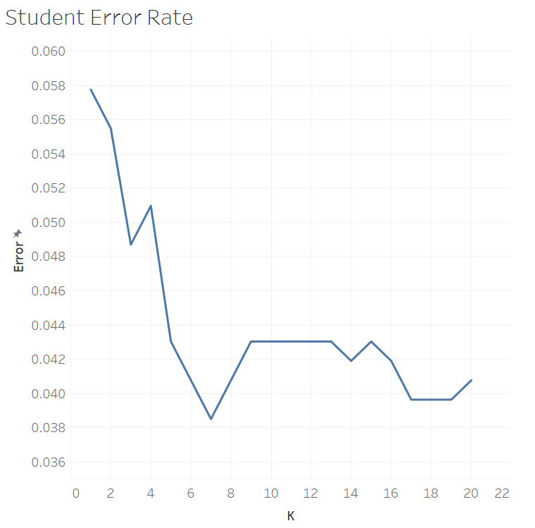
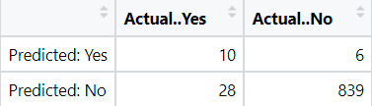
KNN – STUDENT
We checked k values from 1 to 20 and the best k value turns out to be 7 with error rate = 3.85%
On the Student Dataset KKN was able to predict default correctly 849 times out of 883 attempts (96.14% accuracy). Here is the confusion matrix for the student dataset.
Best k value!
Sensitivity: 10 / 38 = 26.31%
Specificity: 839 /845 = 99.28%

Slide 20
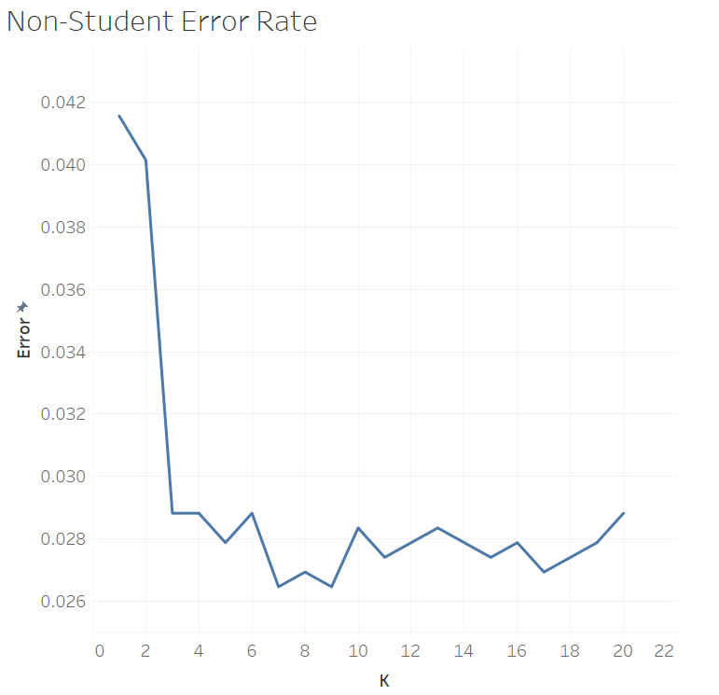
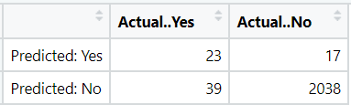
KNN – NON STUDENT
We checked k values from 1 to 20 and the best k value turns out to be 7 with error rate = 2.64%
On the Non-Student Dataset KNN successfully predicted default category 2061 times out of 2117 attempts (97.35% accuracy). Here is the confusion matrix for the non-student dataset.
Best k value!
Sensitivity: 23 / 62 = 37.09%
Specificity: 2038 / 2055 = 99.17%

Slide 21
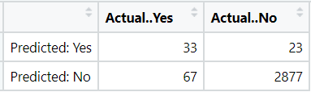
K NEAREST NEIGHBORS
In total KNN was successful 849 + 2061 = 2910 times out of 3000 attempts. Giving 97% accuracy.
Here is the confusion matrix for the KNN.
Our model has a very high accuracy but low sensitivity. This is the same with the Logistic Regression Model.
Again, this fact might be problematic as most credit card companies care more about accurately predicting customers who actually defaulted than accurately predicting customers who won’t actually default.
Sensitivity: 33 / 100 = 33%
Specificity: 2877 / 2900 = 99.20%

Slide 22
CONCLUSION
In conclusion, the Logistic Regression Model is better than the KNN. In terms of accuracy the Logistic Regression Model performs slightly better than the KNN with 97.63% accuracy instead of KNN’s 97% accuracy. We might also prefer the logistic model since it has higher sensitivity than KNN with 37% instead of KNN’s 33%.
However both of these models are not good enough to be used in the real world. Their sensitivity rates are too low. Further improvements to the models are required.
It is important to note that because only 3.33% of all observation defaulted then a simple classifier that predicts every single observation to be in the non-default category regardless of any information available will get on average 96.66% accuracy. Thus our models are only slightly better in terms of accuracy than this null classifier.

Slide 23
Thanks!

Slide 24
Images Sources:
Cover image: https://upgradedpoints.com/best-premium-luxury-credit-cards/
ISLR book: https://awesomeopensource.com/project/JWarmenhoven/ISLR-python
Contact me:
Github: https://github.com/JonathanRyanW
Linkedin: https://www.linkedin.com/in/jonathan-ryan-wilianto/
WA: (+62) 895365313233

